Slide 1
Azure Cloud Native Pipelines accelerator
CONFIDENTIAL | © 2021 EPAM Systems, Inc.

Slide 2




Summary
Features
Cloud Native providing easy scaling, built-in security, high-availability and simplified growth of complexity and development.
Solution is based on wildly spread and well-known market leading DevOps tools: Azure DevOps Services and Terraform.
Automated initial setup and bootstrapping in less then 30 minutes.
Allows multiple branching policies and support git-flow and trunk branching strategies out of the box.
Built-in support of multiple programming languages: .NET Core, ASP .NET, JAVA, JavaScript.
Benefits
Amplify reusability, governance and standardization of CI/CD pipelines and infrastructure across the organization.
Accelerate establishment of the efficient and automated release strategy, improving velocity and time to market x-times.
Embrace easy scalability and simplified centralized management of a fast-growing ecosystem.
Our clients

Slide 3



Thomson Reuters - migrate to Azure DevOps Services
CHALLENGES
20+ legacy on-prem applications
Unstructured CI/CD processes
Low maintainability and scalability
High error rate due to low level of automation
On-premise DC
Azure DevOps Services
Delivery team
Delivery team
Delivery team
Result
Manual deployments
CI\CD refactoring and migration to Azure DevOps
DevOps best practices consolidation
Maintainable infrastructure blueprints and automation
Time to market decreased
Increased deployment frequency
Decreased deployment failure rate
Complexity
Standardization
Automation
Predictability
Cloud Native Pipelines
Low deployment reliability
Hard to control

Slide 4
Solution overview
Cloud Native Pipelines
Aggregates a reusable modules for CI/CD pipelines, sets of infrastructure modules, and documentation to accelerate and establish the CI/CD process.
Modular architecture provides outgoing functionality and may be extended by custom modules for specific needs of the delivery teams.
Based on Azure DevOps Service orchestration capabilities and Terraform for infrastructure provisioning.
Benefits
Improves velocity and time to market by speedup bootstrap processes.
The modular and multi-repo approach used in the solution provides good scalability and manageability in the long-term run.
Centralized approach manage DevOps processes.
axa
Best practices
Infrastructure modules
CI/CD modules
Documentation
Accelerator Pack
Scalability
Maintainability
Centralization
Time to market speed-up
Long-term solution
Contribution support

Slide 5
Solution reusability and templatizing
Delivery team
CNP
Delivery team
CI/CD referencing
CI/CD YAML templates
CI/CD referencing
Infrastructure referencing
Infrastructure templates
Infrastructure referencing
Delivery team consumes templates using Azure DevOps referencing capabilities
Cloud Native Pipelines server as a core for multiple Delivery teams
Delivery team consumes templates using Azure DevOps referencing capabilities

Slide 6
Functionality
Supporting Azure: AppServices, AKS, Networking, Cosmos DB, Azure SQL, Azure Monitor, Key Vault, Storage Account.
Infrastructure components
Networking
Compute
Data
Monitoring
CI/CD Modules
Frameworks
Release processes
Container builds
Deployment types
Recreate
Blue-Green

Slide 7
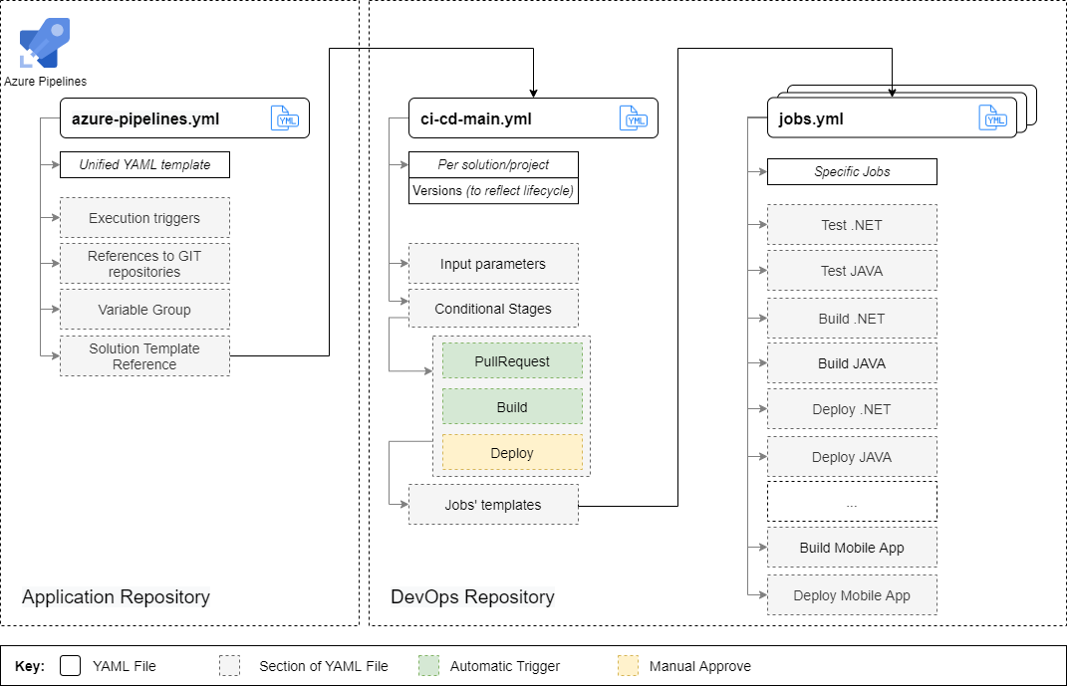
Pipeline's structure

Slide 8
Distribution model
Cloud Native Pipelines
Customer’s target solution
DevOps Project
DevOps Project
Azure Cloud resources
Pipelines
Pipelines
VNET
Terraform modules
Terraform modules
ACR
Documentation
Documentation
AKS
Artifact.zip
Manual run
KeyVault etc.
Application Project
Application Project
Pipelines
Pipelines
Application deployment
Documentation
Documentation

Slide 9


EPAM common approach for Engineering Platforms
Features
Cloud Native providing easy scaling, built-in security, high-availability and simplified growth of complexity and development.
Solution is based on wildly spread and well-known market leading DevOps tools: Azure DevOps Services and Terraform.
Automated initial setup and bootstrapping in less then 30 minutes.
Allows multiple branching policies and support git-flow and trunk branching strategies out of the box.
Built-in support of multiple programming languages: .NET Core, ASP .NET, JAVA, JavaScript.
Benefits
Amplify reusability, governance and standardization of CI/CD pipelines and infrastructure across the organization.
Accelerate establishment of the efficient and automated release strategy, improving velocity and time to market x-times.
Embrace easy scalability and simplified centralized management of a fast-growing ecosystem.
Our clients

Slide 10
Case study: Thomson Reuters adopted EPAM Cloud Native pipelines accelerator
On-premise DC
Azure DevOps Services
Delivery team
Delivery team
Delivery team
Challenges
20+ legacy on-prem applications in scope of migration to Azure Cloud
Missing automated CI/CD pipelines and centralized release and infrastructure management
Low level of automation leading to poor maintainability, scalability and 35% of unsuccessful releases
Manual deployments
Complexity
Standardization
Automation
Predictability
Low deployment reliability
Cloud Native Pipelines
Hard to control
Result
Adoption of EPAM Cloud Native pipelines added value: consolidated governance, boosted reusability, scalability and resilience
Improved time-to-market by 50%, increased deployment frequency to multiple times per week.
Implemented reusable easy to maintain automated infrastructure blueprints and scripts decreasing deployment failure rate and release issues by 100%

